Slide 1
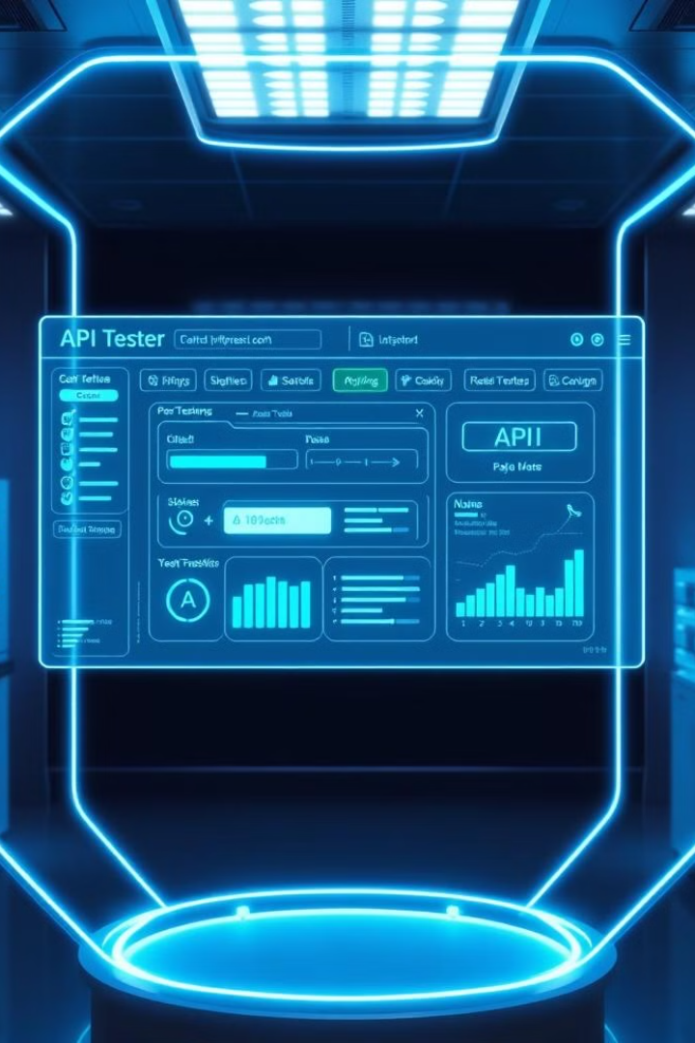
SOAP UI: Powerful API Testing Tool
SOAP UI is an open-source tool for testing web services. It supports SOAP and REST APIs, offering functional, regression, and load testing capabilities with a user-friendly interface.

Slide 2

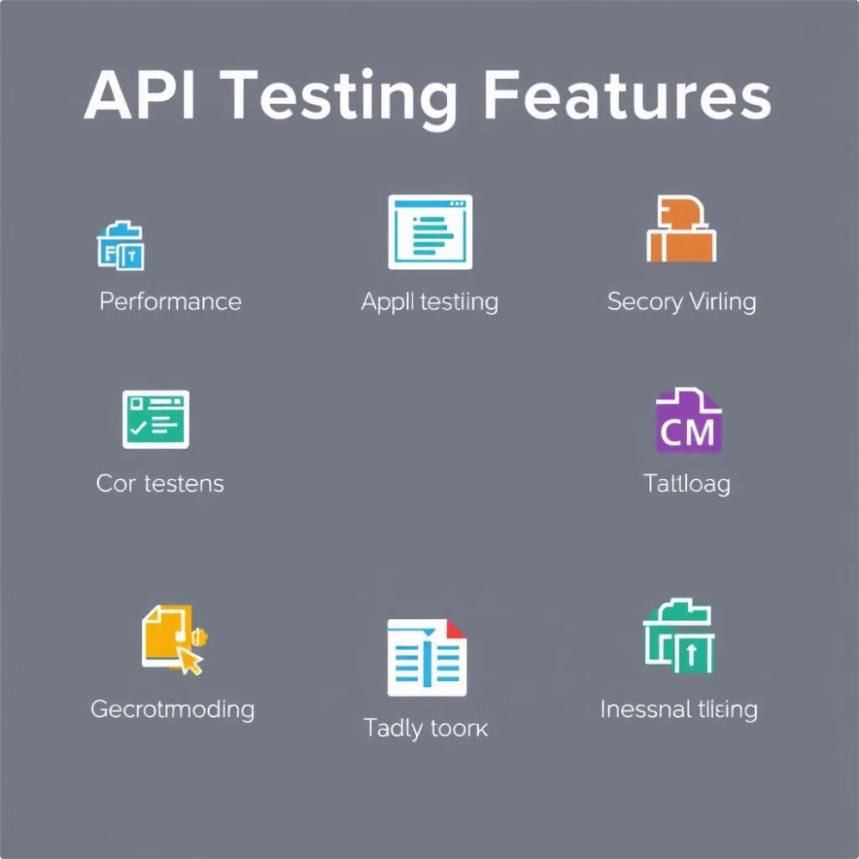
Key Features of SOAP UI
1
API Support
Tests both SOAP and RESTful web services.
2
Testing Types
Offers functional, automated, load, and security testing.
3
Data-Driven
Supports testing with various data sets from external sources.

Slide 3


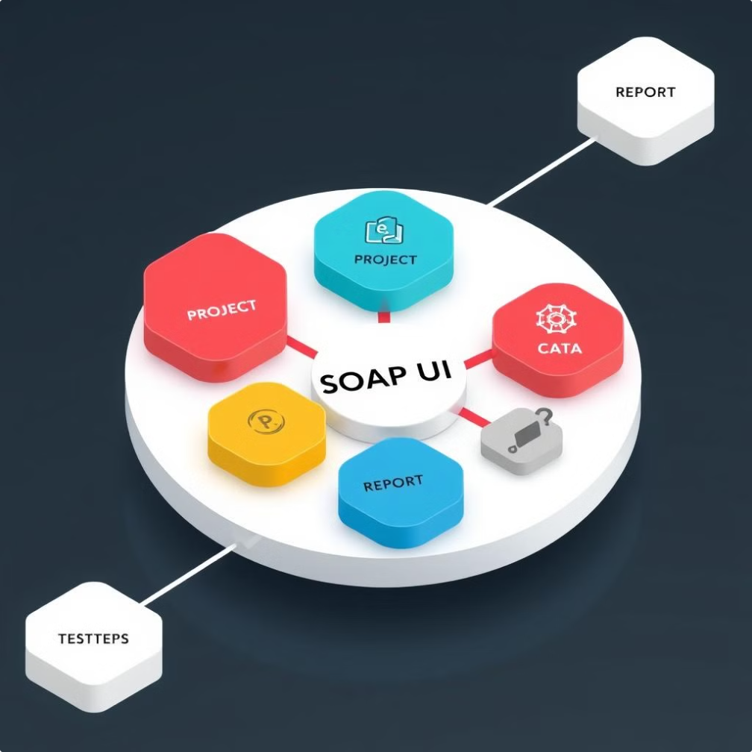


SOAP UI Components
Test Case
Core unit for creating functional tests.
Test Suite
Collection of related test cases.
Assertions
Validate API responses and data.

Slide 4

How SOAP UI Works
Create Project
1
Set up a container for API endpoints and configurations.
2
Add Endpoint
Import WSDL file or provide REST API URL.
Create Tests
3
Define operations to test API functionality.
4
Execute and Review
Run tests and analyze detailed logs.

Slide 5






Simple SOAP Test Example
Create Project
Enter WSDL URL to start.
Add Test Suite
Right-click project and create new suite.
Create Test Case
Add test case within the suite.
Add Test Step
Choose "SOAP Request" for the step.

Slide 6

REST API Testing Example
Create REST Project
Set Parameters
Add REST API URL to begin.
Add query parameters, headers, and request body.
1
2
3
4
Define HTTP Methods
Add Assertions
Specify GET, POST, PUT, DELETE, etc.
Validate response with status codes and schema checks.

Slide 7
Common Use Cases for SOAP UI
Functional Testing
Load Testing
Security Testing
Validate API endpoints' behavior.
Stress-test APIs with simulated users.
Identify vulnerabilities using built-in scans.

Slide 8

Best Practices for Using SOAP UI
Effective Assertions
Validate both API call success and data correctness.
Modular Design
Create reusable test components to reduce redundancy.
Data-Driven Tests
Use external data sources for robust testing.
CI/CD Integration
Automate tests within your development pipeline.

Slide 9




Advantages of SOAP UI
API Support
User-Friendly GUI
Open-Source
Tests both SOAP and REST APIs.
Easy-to-use interface for complex API tests.
Free version with comprehensive functionality.

Slide 10
Disadvantages and Conclusion
Disadvantages
Conclusion
Resource-intensive for large projects
SOAP UI is a powerful, user-friendly tool for API testing. It simplifies functional, load, and security testing in agile environments.
Learning curve for advanced features
Limited reporting in free version

